Slide 1
Understanding the ageing patterns of the population in North West London: A survival analysis
Dr Santosh Kumar & Dr Yihan Xu from the HEU team
22 Sep 2022

Slide 2
Table of content
Introduction
Background
Literature review
Key research questions
Methodology
Study population
Analytical approaches
Preliminary findings
Conclusions and recommendations

Slide 3
Introduction

Slide 4
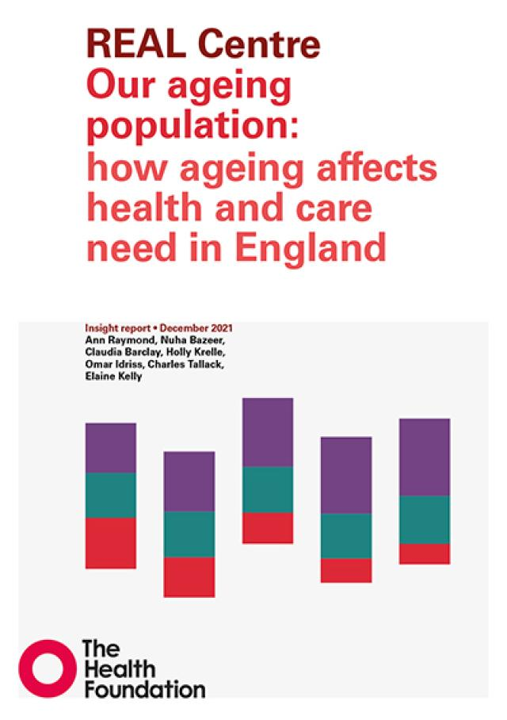
Background
As health care needs increase with morbidity, morbidity increases with age, it is natural to predict future demand for health care will continue to grow as England enters an ageing society (the number of people older than 65 is projected to increase from 12 million in 2019 to 17 million in 2039
However, recent research by the REAL centre — ‘Our ageing population: How ageing affects health and care need in England’ — indicates that increased longevity alone does not necessarily translate to higher lifetime health care needs due to older people staying healthy for longer. A more critical driver is the trajectory of morbidity (periods of ill health) among the elderly.

Slide 5
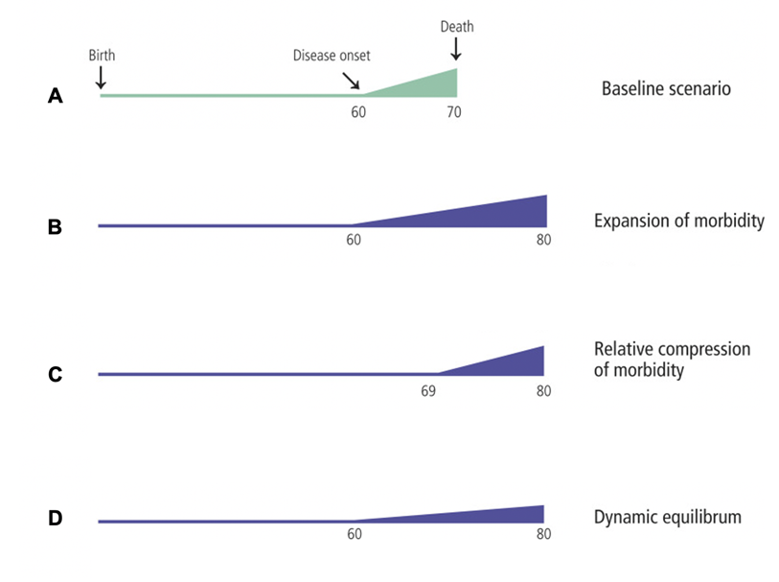
Literature review – does longevity always lead to higher lifetime health care needs?
The morbidity expansion theory argues that increased life expectancy would lead to higher health care needs. Olshansky, S. J., Rudberg, M. A., Carnes, B. A., Cassel, C. K., & Brody, J. A. (1991).
The morbidity compression theory argues that increased life expectancy does not necessarily lead to higher health care needs as onset of morbidity/disability is delayed. Fries, J. F. (1980).
The “dynamic equilibrium” theory, which seeks to establish a middle ground between the two theories. It suggests that the time people spend in illness will increase with life expectancy, but the illness will be less severe. Rechel, B., Jagger, C., & McKee, M. (2020).
Figure 1. Scenarios of ageing (decline in health or increase in morbidity) patterns, adapted from Rechel, Jagger & Mckee (2020)
Notes:
As health spending increases with morbidity, morbidity increases with age, it is natural to predict the health expenditure will continue to grow as England enters an ageing society (the number of people older than 65 is projected to increase from 12 million in 2019 to 17 million in 2039). However, recent research indicates that increased longevity alone does not necessarily translate to higher lifetime health care spending due to older people staying healthy for longer. A more critical driver of lifetime health expenditure is the trajectory of morbidity (periods of ill health) among the elderly.
So what does the trajectory look like?
(Stephan Morris book, P. 34) Zweifel et al. (1999) examined the hypothesis that the main determinant of high health care costs amongst older people is not the time since they were born, but the time until they die. Their results, conﬁrmed by many subsequent studies, is that proximity to death does indeed explain higher health care costs better than age per se.
The consensus is that ageing per se contributes little to the continuing rise in health expenditures that all countries face. Much more important drivers are improved quality of care, access to care, and more expensive new technology. Of course, all of these may be largely devoted to older people, so that age may be associated with higher costs, but is not the causal factor.

Slide 6
Research questions
To understand how older people experience morbidity as they age, The Health Economics Unit, with support from the REAL centre, explored how the onset of having 2 and more long-term conditions (LTCs) changed over time among people aged 65 or older in North-West London (NWL).
We have two key research questions:
What are the general patterns of ageing (i.e., when the onset of more than 2 long-term conditions occurred) in North-West London?
Do the patterns of aging differ by gender, ethnicity, and deprivation? And if yes, how?

Slide 7
Methodology – Study population

Slide 8
Data source
Data source
Large linked longitudinal dataset (N= 394,468) comprising health and social care data of people registered with a GP in Northwest London
We analysed data of those aged 65 or older between 1 Jan 2015 and 31 Dec 2021.
Key variables in the data set
No of long-term conditions
Demographic Information (Age, Gender, Ethnicity, IMD Decile)
Year of Age

Slide 9


Study population – Characteristics
9
The population size of the 2015 cohort was ~16 times bigger than the later cohorts
First cohort in 2015, aged 65 - 90
Over the years, the sex ratio and average age remained stable
Every year around 20,000 newly-turned 65-year-old entered the NWL database
Subsequent cohorts from 2016-2021, aged 65 - 67
2015 2016 2017 2018 2019 2020 2021

Slide 10
Methodology – Analytical approaches

Slide 11
Analytical approach - survival analysis
Survival analysis, also known as “time to event analysis”, refers to a set of methods to study not only if an event happens but also when it happens
In survival analysis time is measured for each patient from the first observation until when an event happens or when time is censored.
Time typically stops when:
An event occurs (We defined event of interest as status (1 = Yes; 0 = No) of having 2 or more LTCs (2+ LTCs)
The study is out of time or end (2021)
A patient lost to follow-up or dies from other causes.

Slide 12
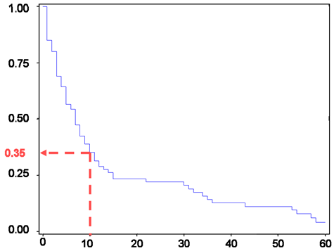
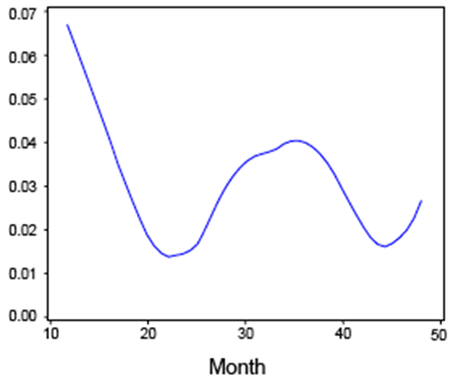
Survival analysis steps
Step 1: Define Event, Time and Censoring
Step 2 :Estimate the survival/hazard functions.
Step 3: Compare the functions between two or more groups.
Step 4: Assess the impact of predictors on survival rates.
Survival function: Probability of an event happening sometime after a time point
Hazard function: Instantaneous risk of having an event given the patient is still at risk
Survival Plot
Hazard Plot
Probability of event happened
cumulative hazard
Month

Slide 13
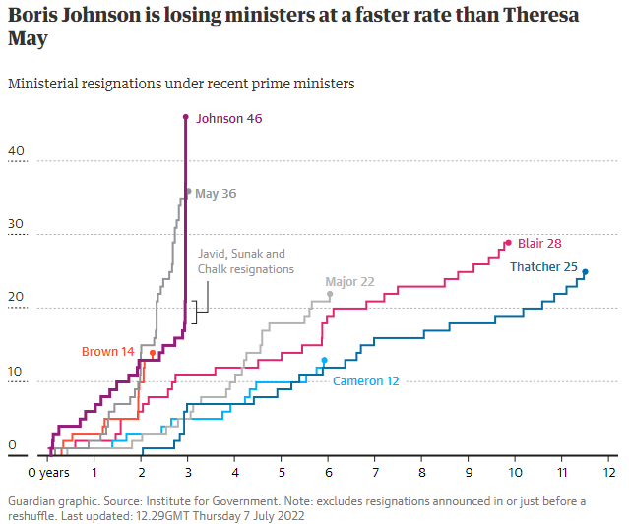
How to interpret survival analysis plots- using the premiership of Boris Johnson as an illustrative example
% of Bojo remaining PM
Event of interest
100%
BoJo in ICU
Party gate news
No confidence vote
50%
Rishi and Javid resigned
0%
Year 1 Year 2 Year 3
Time to event
Time since elected PM

Slide 14
Preliminary findings & conclusions

Slide 15
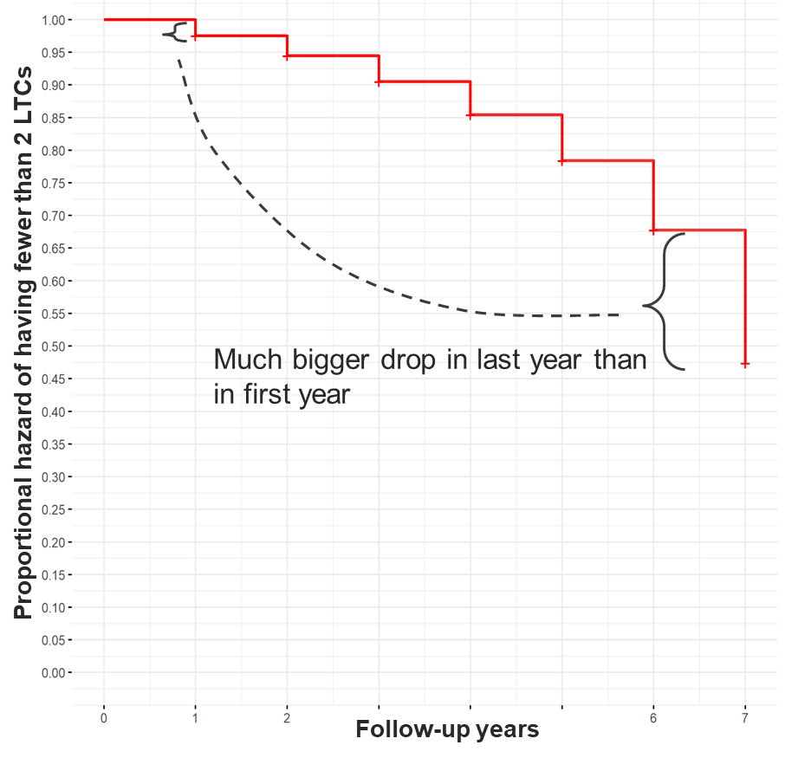
How did the risk of having 2 or more LTCs change?
Description of the figure
The hazard of having fewer than 2 LTCs decreased at an accelerating rate. It dropped by 0.03 from Year 1 to Year 2, and by 0.2 from Year 6 to Year 7
Interpretation of findings
Gradual and then sudden change. For older people in NWL, the occurrence of having fewer than 2 LTCs accelerated at each time point
→ This indicates that the risk of having 2+ LTCs increases at each time point. And, the likelihood of having none or one LTC at the end of year 7 is 50%.

Slide 16
Did the proportion hazard of older people with 2 or more LTCs differ by deprivation level?
Variable |  | Hazard ratio | P-value
Gender | Female | Ref
 | Male | 1.06 | <0.001
Age group | 65-69 | Ref
 | 70-74 | 1.19 | <0.001
 | 75-79 | 1.41 | <0.001
 | 80-84 | 1.50 | <0.001
 | 85+ | 1.15 | <0.001
Ethnicity | White | Ref
 | Asian | 1.34 | <0.001
 | Black | 1.23 | <0.001
 | Mixed | 1.16 | <0.001
 | Others | 0.89 | <0.001
Deprivation | Least deprived | Ref
 | 4 | 0.98 | <0.001
 | 3 | 1.05 | <0.001
 | 2 | 1.10 | <0.001
 | Most deprived | 1.18 | <0.001
Description of the regression
The hazard ratios were adjusted by all demographic variables
The reference group has a hazard ratio of 1
A hazard ratio smaller than 1 is associated with a lower risk of having 2+ LTCs
A hazard ratio bigger than 1 is associated with a higher risk of having 2+ LTCs
The overall trends are consistent with what the figures show
Interpretation of findings
The groups that had higher hazard ratio of having 2+ LTCs are: males, aged 75 and above, Asian and Black, people living in the most deprived areas. See the left figure for hazard ratio and p-value.

Slide 17
Key findings from survival analysis
The onset of having 2+ LTCs among older people differs substantially by demographic characteristics.
Those who are Asian and Black or living in the most deprived areas are more likely to have greater health care needs sooner.
The gender difference is small, though significant
The Asian (1.34 95% CI [1.34, 1.35]) and Black (1.23 95% CI [1.12, 1.25]) ethnic groups have a significantly higher hazard ratio of having 2+ LTCs compared to the White during the follow-up period
Similarly, for deprivation, people living in the most deprived areas had the highest hazard ratio (1.18, 95% CI [1.16, 1.19]).

Slide 18
Key takeaways for aging research
Recapping the three scenarios of aging from the literature review
As the population ages, morbidity increases in a “gradual-then-sudden” pattern:
The rate is slow in early old age whereas it then accelerates, suggesting that the trajectory is perhaps more curvilinear than linear
The current preliminary findings therefore suggest that the process we observed may be like a variant of the dynamic equilibrium theory
What might be the case in England –
A variant of dynamic equilibrium
E
69 80

Slide 19
Recommendations and caveats
Recommendations
Future modelling of health expenditure may consider the curvilinear (non-linear) nature of the rate at which people have greater health care needs
We may not have a single scenario of the ageing trajectory that is applicable for all subgroups of the populations, and it is possible that the lifetime health expenditure will decrease for lower-risk subgroups while increase for the higher-risk groups
Targeted preventative interventions might be needed to delay the critical age for higher-risk groups
Caveats
Our analyses were based on NWL data only, and although the sample size was big, it only spanned 7 years. Ideally we would like to replicate the analysis using longitudinal data with a longer time horizon.
We used the number of LTCs as a proxy for overall health status, and we acknowledge that this proxy is not always accurate (some people may feel very healthy despite having multiple LTCs, and the increase in the number of LTCs might reflect increased health awareness instead of decline in health).

Slide 20

The Health Economics Unit, part of MLCSU
Health Economics Unit’s team of experts enable health system and industry leaders to make the best decisions, designing the highest quality, most efficient and innovative services, ultimately improving the health of communities
Our vision is leading the generation of world-class evidence through economics and analytics, improving health and care
Our mission is the best possible health and care through evidence-based decision-making
Passionate: we are a highly motivated team who do projects which excite us and stretch our thinking
Outstanding: we use our vast knowledge, experience and network to provide high-quality products and achieve our clients’ aims
Collaborative: we share our knowledge, invest in our community and value our diversity
Our passionate team has significant breadth of experience, with the skills needed to develop models and evaluations, to generate evidence from integrated, real-world datasets to inform complex health decisions, and to create positive change across health systems

Slide 21
Any questions?

Slide 22
Contributors:
Santosh Kumar, Lead analyst
Yihan Xu, Senior Health Economist
Santosh.kumar3@nhs.net
yihan.xu@nhs.net
https://healtheconomicsunit.nhs.uk/

Slide 23
Appendix

Slide 24


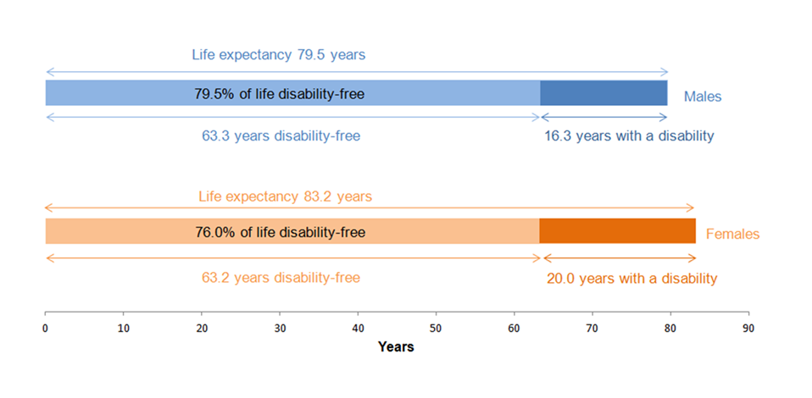
Literature review – which is most applicable to England? A mixed picture
Supporting Morbidity Expansion Theory
Supporting Morbidity Compression Theory
A previous study shows that increases in healthy life expectancy (number of years spent in good health) in the UK did not match the pace of increase in life expectancy, particularly among the elderly up to 2015. (Jagger, C., 2015).
More recently, the Health Profile for England report also shows that the healthy life expectancy was 63.5 years for females and 63.2 years for males in 2017 to 2019 and has been stagnant since 2012. (ONS, 2015)
Little empirical evidence in the UK context
There is some initial empirical evidence in the U.S. supporting this theory, including the accelerating declining trends of disability since 1982, the postponement of onset of disability from 7 to 12 years, and overall reduction in health risks and medical care utilisation. (Fries, 2003)
A recent systematic review found that relative compression of morbidity was evident due to smoking cessation programmes — non- and never-smokers experience less unhealthy life years compared to people who smoke. (Dieteren, C. M., Faber, T., Van Exel, J., Brouwer, W. B. F., Mackenbach, J. P., & Nusselder, W. J. (2021).
In 2012:
Female - 63.3 years
Male - 63.2 years
Notes:
There is some initial empirical evidence supporting this theory, including the accelerating declining trends of disability since 1982, the postponement of onset of disability from 7 to 12 years, and overall reduction in health risks and medical care utilisation. Fries, J. F. (2003). Measuring and monitoring success in compressing morbidity. Annals of Internal Medicine, 139(5_Part_2), 455. doi: 10.7326/0003-4819-139-5_Part_2-200309021-00015
A recent systematic review found that relative compression of morbidity was evident due to smoking cessation — non- and never-smokers experience less unhealthy life years compared to people who smoke. Dieteren, C. M., Faber, T., Van Exel, J., Brouwer, W. B. F., Mackenbach, J. P., & Nusselder, W. J. (2021). Mixed evidence for the compression of morbidity hypothesis for smoking elimination—a systematic literature review. European Journal of Public Health, 31(2), 409–417. doi: 10.1093/EURPUB/CKAA235

